Slide 2
Metataxonomics

Slide 3
The Taxonomic Analysis workshop

Slide 4
Metataxonomics
The study of the taxonomic composition of microbiomes
Is not the same as metagenomics
Is interesting because microbiomes affect everything

Slide 5
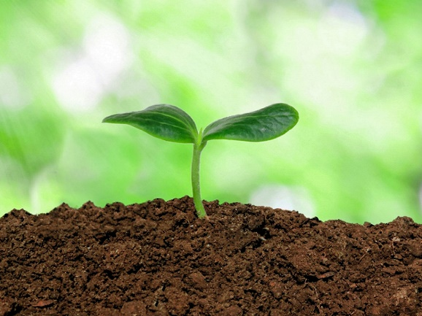

Bifidobacterium?
Lactobacillus?
Clostridium?
E. coli?

Slide 6
16S ribosomal rRNA gene

Slide 7
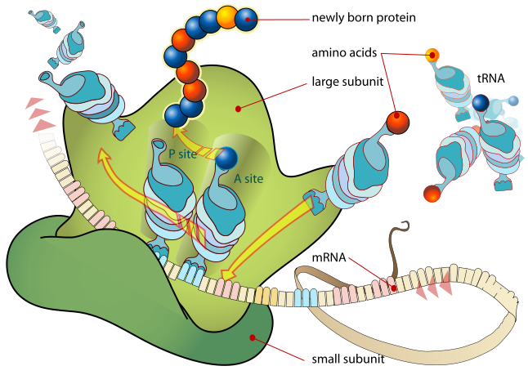

Slide 8
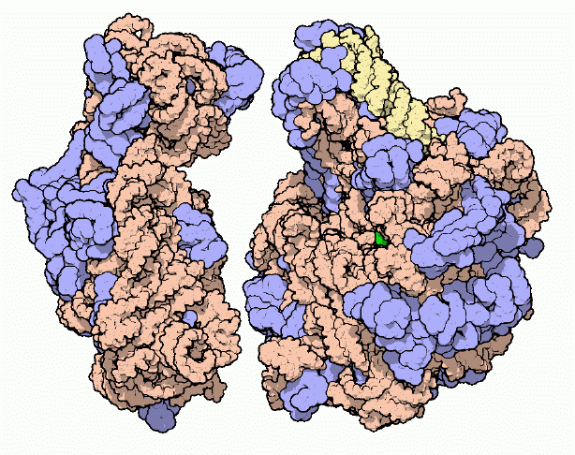

Slide 9
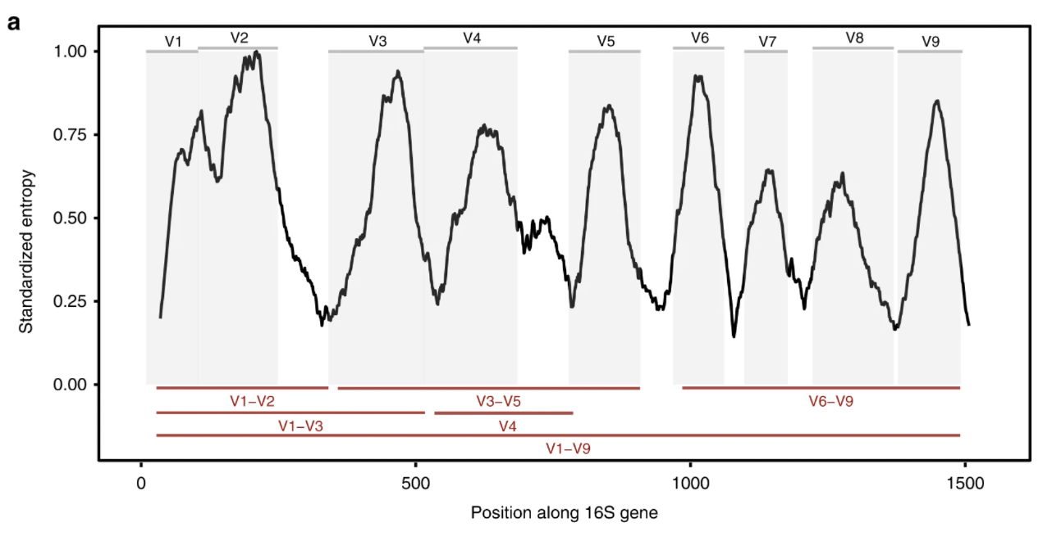
Variable regions
Primers match ‘all’ bacteria
Amplicon is ‘unique’ for each
Constant regions

Slide 10
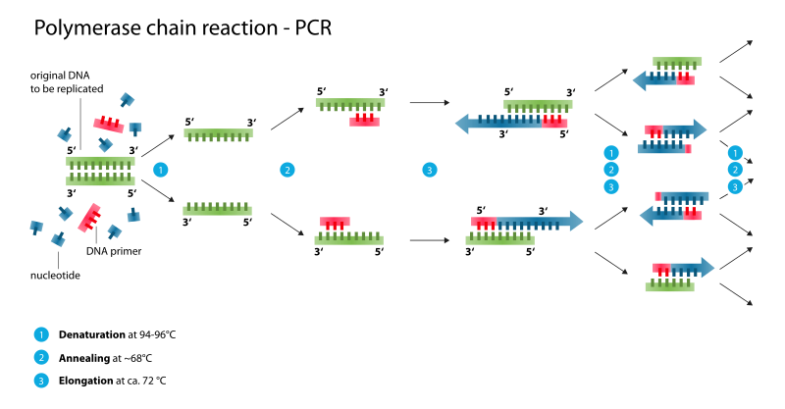
Unique sample-specific barcode

Slide 11
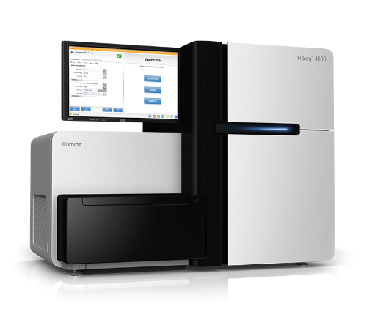
Illumina MiSeq
Billions of DNA-molecules
+10k reads per sample
Milions in total

Slide 12
Sidebar – Illumina sequencing is paired
*_1.fastq
*_2.fastq

Slide 13
Their method
Filter
Assemble
Demultiplex
Sample 4
Sample 1
Sample 2
Sample 3

Slide 14
Sample 1
Sample 2
Sample 3
Sample 4
Rarify
Sample 1
Sample 2
Sample 3
Sample 4
Cluster at 97%
Sample 1
Sample 2
Sample 3
Sample 4

Slide 16
#4 of OTU 3
#4 of OTU 1
97% nucleotide identity
Probably a species
#2 of OTU 4
#7 of OTU 2

Slide 17
Modern method
Error correct
Assembly
Demultiplex
Sample 4
Sample 1
Sample 2
Sample 3

Slide 18
Sample 1
Sample 2
Sample 3
Sample 4
Rarify
Sample 1
Sample 2
Sample 3
Sample 4
Cluster at 97%
Sample 1
Sample 2
Sample 3
Sample 4

Slide 19
OTU_475
ACGTCCG…GGTA
ACCTACG…GCTA
ACGGTCG…GTTA
.
.
.
ACGTCCG…GGTA
ACGGTCA…GGTA
Escherichia coli
Vibrio angularium
.
.
.
Lactocaseibacillus casei
Treponema sp.
ASV_6542
Lactocaseibacillus casei

Slide 20
Abundance tables
 | Bacteria_Proteobacteria_Gammaproteobacteria_Enterobacterales_Enterobacteriaceae_Escherichia-Shigella | Bacteria_Firmicutes_Bacilli_Lactobacillales_Lactobacillaceae_Lactobacillus | Bacteria_Bacteroidota_Bacteroidia_Bacteroidales_Prevotellaceae_Prevotella | Bacteria_Firmicutes_Clostridia_Clostridiales_Clostridiaceae_Clostridium sensu stricto 1 | Bacteria_Firmicutes_Negativicutes_Veillonellales-Selenomonadales_Veillonellaceae_Megasphaera | Bacteria_Firmicutes_Clostridia_Oscillospirales_Butyricicoccaceae_NA | Bacteria_Firmicutes_Clostridia_Oscillospirales_Ruminococcaceae_Subdoligranulum | Bacteria_Firmicutes_Negativicutes_Veillonellales-Selenomonadales_Selenomonadaceae_Anaerovibrio | Bacteria_Firmicutes_Clostridia_Oscillospirales_Ruminococcaceae_Faecalibacterium | Bacteria_Proteobacteria_Gammaproteobacteria_Enterobacterales_Yersiniaceae_Yersinia | Bacteria_Firmicutes_Clostridia_Peptostreptococcales-Tissierellales_Peptostreptococcaceae_Terrisporobacter
sample 1 | 8889 | 16580 | 5346 | 1558 | 2246 | 2660 | 3148 | 1285 | 1260 | 0 | 1385
sample 2
sample 3 | 257 | 7073 | 4820 | 18438 | 58 | 0 | 1888 | 250 | 264 | 0 | 2602
sample 4 | 1411 | 4328 | 13071 | 980 | 746 | 1747 | 5037 | 132 | 3655 | 0 | 190
sample 5 | 768 | 780 | 14969 | 3213 | 285 | 2445 | 8295 | 322 | 1548 | 0 | 910
sample 6 | 1243 | 6064 | 9282 | 1733 | 723 | 1612 | 3216 | 467 | 912 | 0 | 889
sample 7 | 25142 | 2905 | 9387 | 772 | 10431 | 567 | 4134 | 1556 | 513 | 0 | 290
sample 8 | 20256 | 2086 | 1850 | 10593 | 30 | 2294 | 1018 | 197 | 186 | 0 | 2034
sample 9 | 156 | 14937 | 15780 | 1751 | 405 | 1953 | 4386 | 763 | 3352 | 0 | 1011
sample 10 | 11345 | 12468 | 26268 | 374 | 4177 | 751 | 3883 | 3029 | 2951 | 0 | 273

